Slide 1



Slide 2

1 S T E P
By Lucy Gardener

Slide 3
Contents
Proposed Designs
Home Page
Classes Page
Contact Us Page
Mobile Pages
Content Management System/Admin Controls
Technical Details
Legal requirements
Pricing
Timeframe for website
Questions
Refrences
Project Proposal
Target Audience
Client Demands
Mood Boards
Website Hierarchy
Technical Considerations
Dynamic vs Static Sites
Accessibility
Search Engine Optimisation

Slide 4
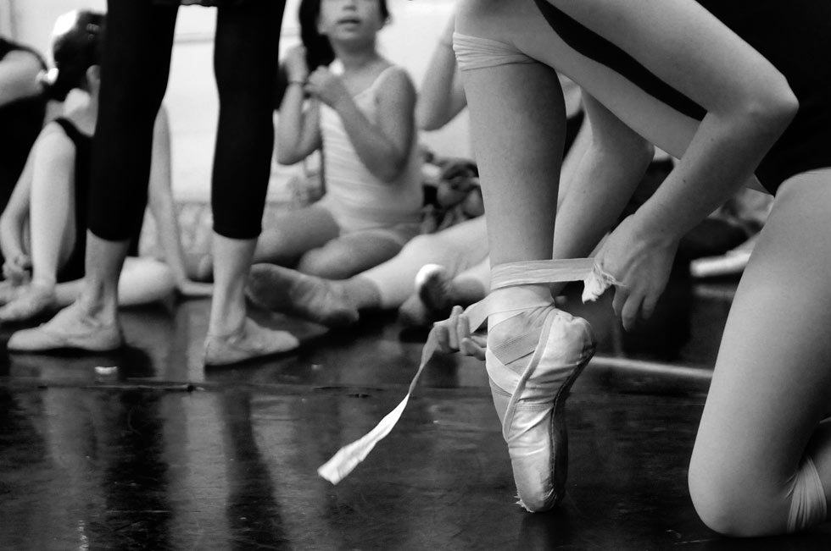
Project
Proposal

Slide 5
Target Audience
1 STEP are a premium contemporary dance studio offering a tuition and training in traditional ballet and abstract dance.
1 STEP offers daily classes, as well as owning a dance studio that individuals and groups can also hire.
Because of this most of the websites main visitors tend ot be professionals; guest shows and groups.
The company do market themselves as a high-end brand, and provides leading facilities.

Slide 6
Client Demands
As 1 STEP are a high-end premium contemporary dance studio, and they have professional clientelle they would like their site to:
Be professional
Include links to common social media
Must be responsive so it works on a lot of different devices

Slide 7
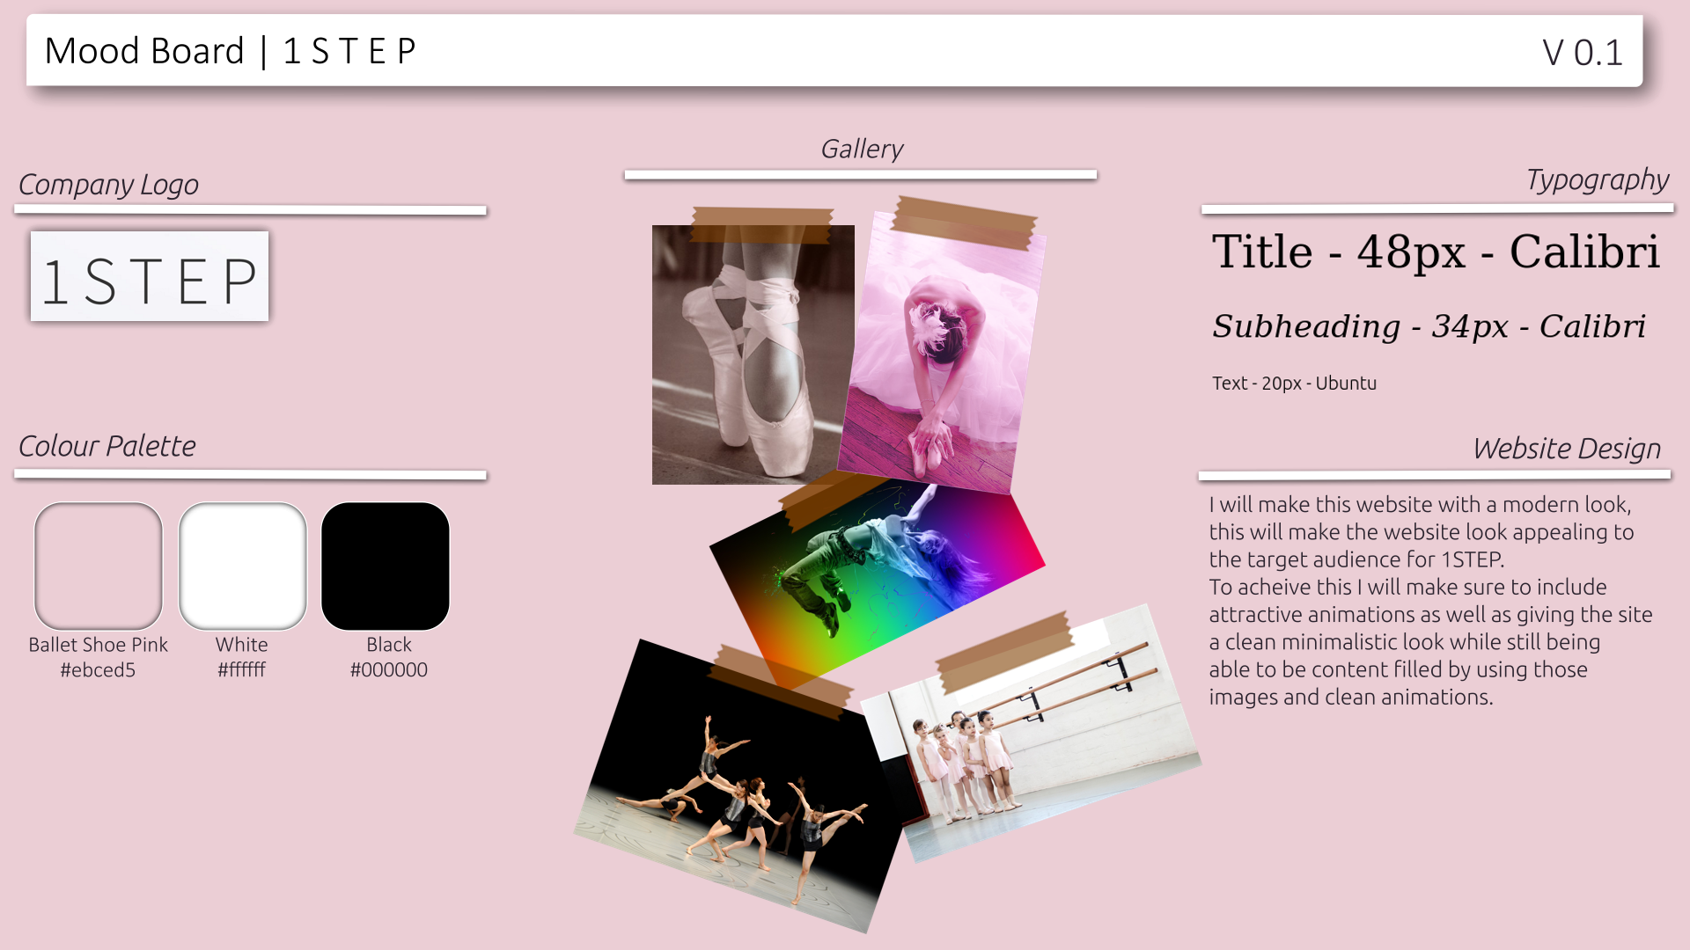
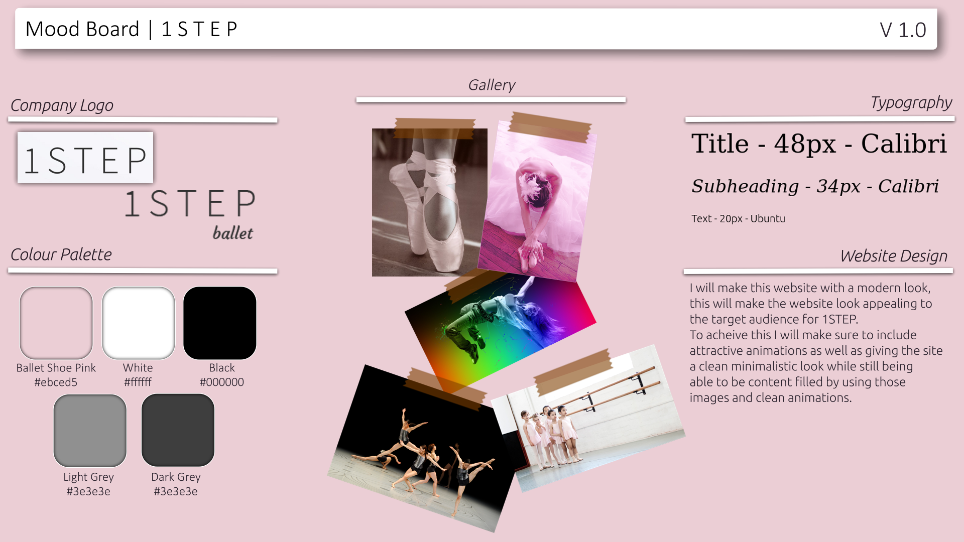
MoodBoards

Slide 8
Website Hiearchy
Home
Classes
Contact Us
Gallery
About
Admin Login
User Management
Content Management

Slide 9

Technical
Considerations

Slide 10
Dynamic vs Static Sites

Slide 11
Accessibility

Slide 12
Search Engine Optimisation (SEO)

Slide 13
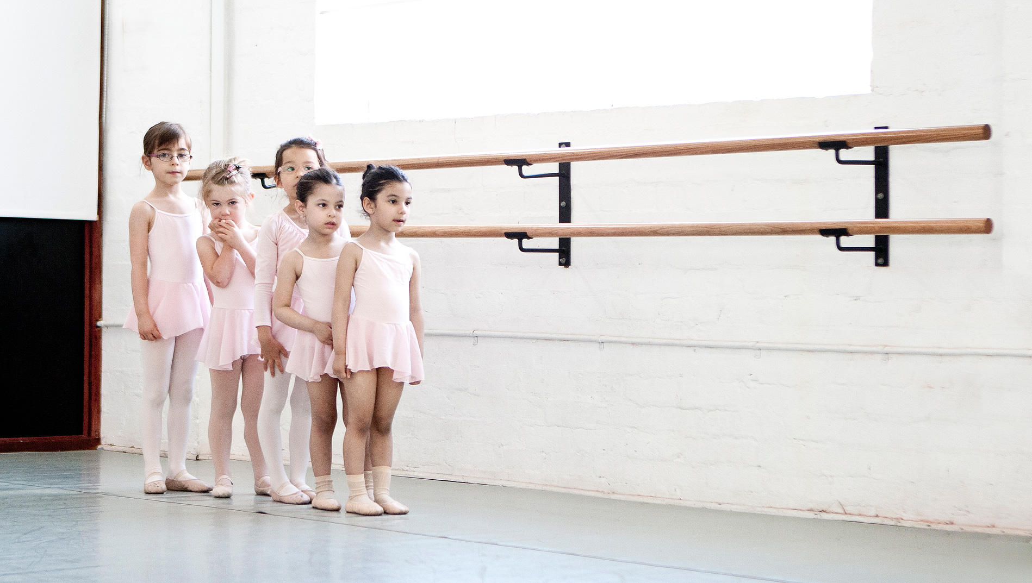
Proposed
Designs

Slide 14
Home Page

Slide 15
Classes Page

Slide 16
Contact Us Page

Slide 17
Mobile Pages

Slide 18
Content Management System/Admin Controls

Slide 19
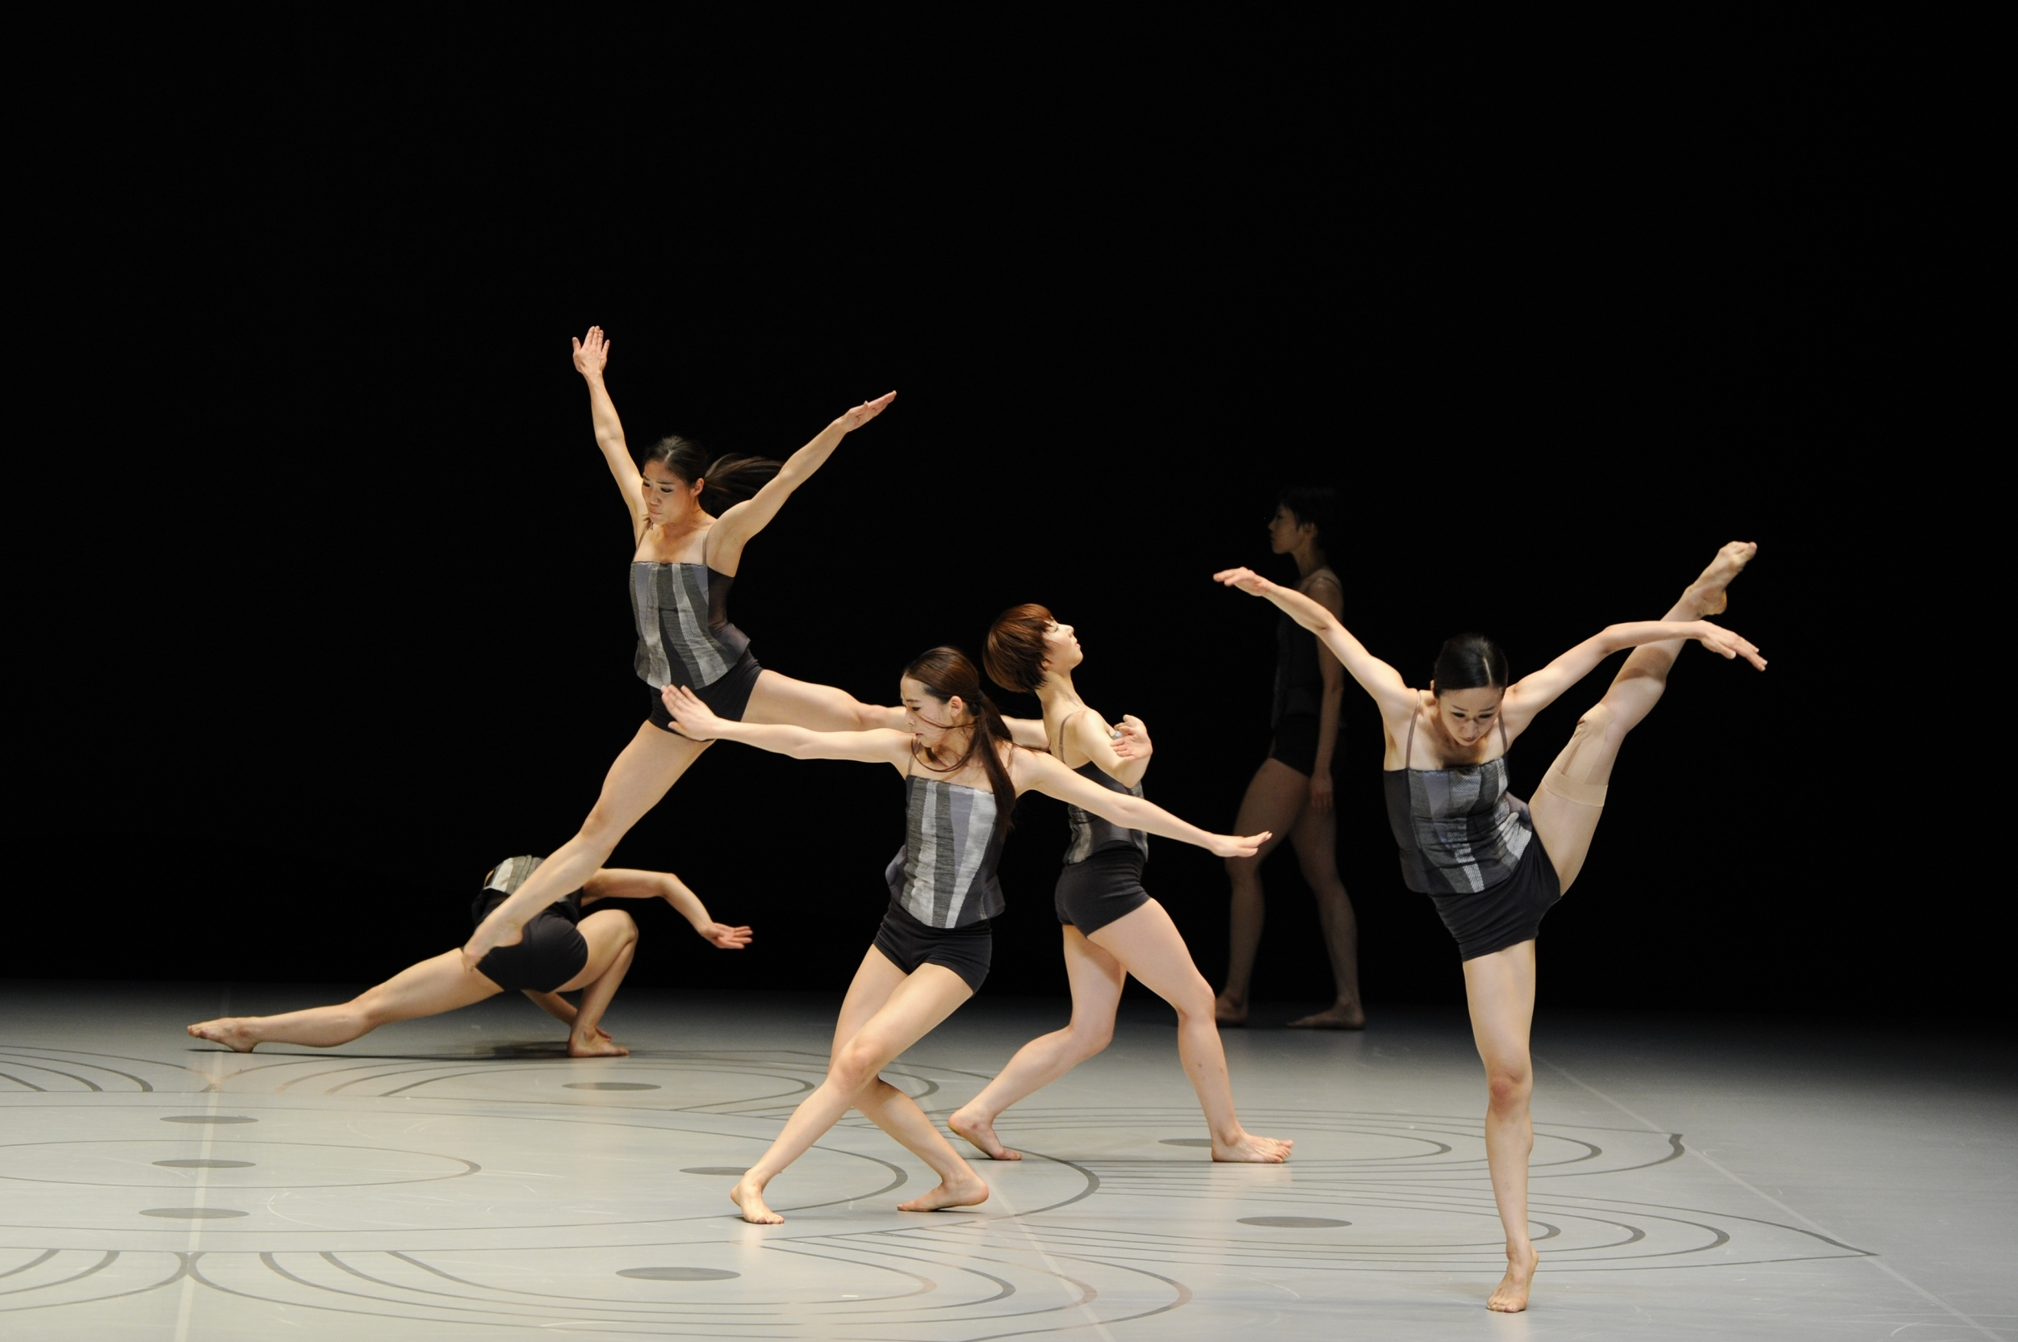
Technical
Details

Slide 20
Legal Requirements

Slide 21
Pricing

Slide 22
Timeframe for Website

Slide 23

Questions

Slide 24
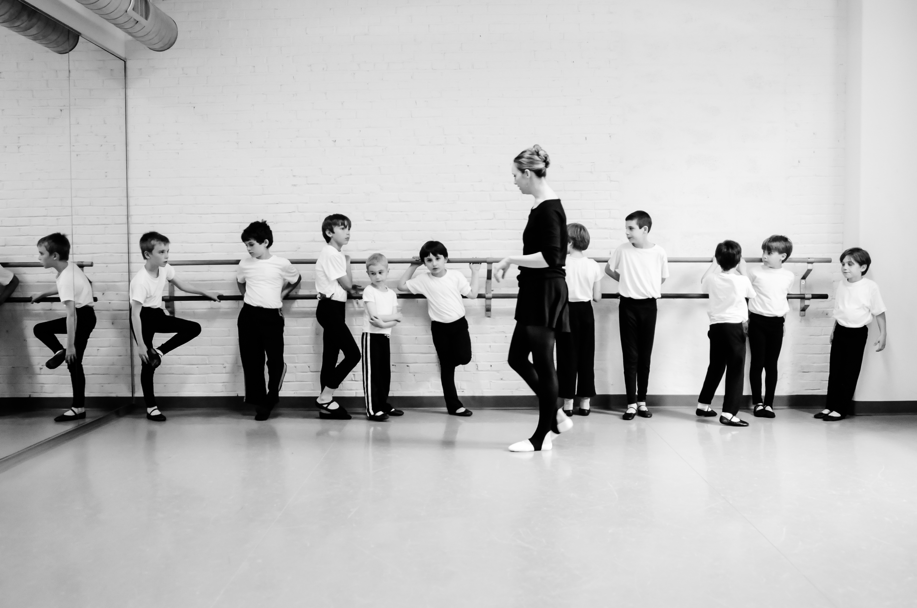
Refrences

